Slide 1

Truck Assignment & Route Optimization
for Cross‑Border Logistics
Mehmet Yusuf Demirci / 31187
Faculty of Engineering and Natural Sciences
Industrial Engineering
https://github.com/mhmtysfdmrc25/-Truck-Assignment-and-Route-Optimization-for-Cross-Border-Logistics-Using-Gurobi

Slide 2
Business Problem & Corridor
Planning corridor: Istanbul → Kapıkule (TR–BG) → Strasbourg (FR entry) → French delivery cities → Kapıkule → Istanbul
Goal: Assign trucks and optimize routes to minimize total cost while satisfying all demands
Cost = Fixed per active truck + Fuel cost × total km (base legs + in‑France legs)
Respect truck capacity and ensure each French delivery node is visited exactly once

Slide 3
Data & Inputs
Distance matrix: square Excel (rows==columns), file: 'distances matrix.xlsx'
Nodes: Origin (Istanbul), Transit (Kapıkule, Strasbourg), Deliveries in France (11 cities)
Demands: defined for French nodes (kg), transit nodes have zero demand
trucks: total 120 (planning up to 110 active). Capacity per truck ≈ 23,000 kg
Costs: Fixed €2,700 per active truck, Fuel ≈ €0.32/km

Slide 4

Data Integrity & Sources
No. All the data determined with the operation team in VIP Lojistik.
The fixed cost includes the driver's progress payment (€920), invoices (€750), and road tolls.
These road tolls include:
Bulgarian toll: €55 one-way
Slovenian toll: €20 one-way
Austrian toll: €220 one-way
Germany toll: €220 one-way
These totals, as an average fixed cost for a truck, amount to €2700 (round trip). Additionally, the fuel cost per km was calculated as follows: a truck consumes 1000 liters of fuel for an average distance of 3200 km. Furthermore, I learned from operation team that, including tax refunds and their own discounts, logistics companies in Europe have an average fuel price of €1/liter. Therefore, the "km_cost" parameter used in the code was calculated and added to €0.32/km.
For distance matrix, I learned the locations and its demands from operation team and construct the distance matrix by hand getting the distances from Google Maps.

Slide 5
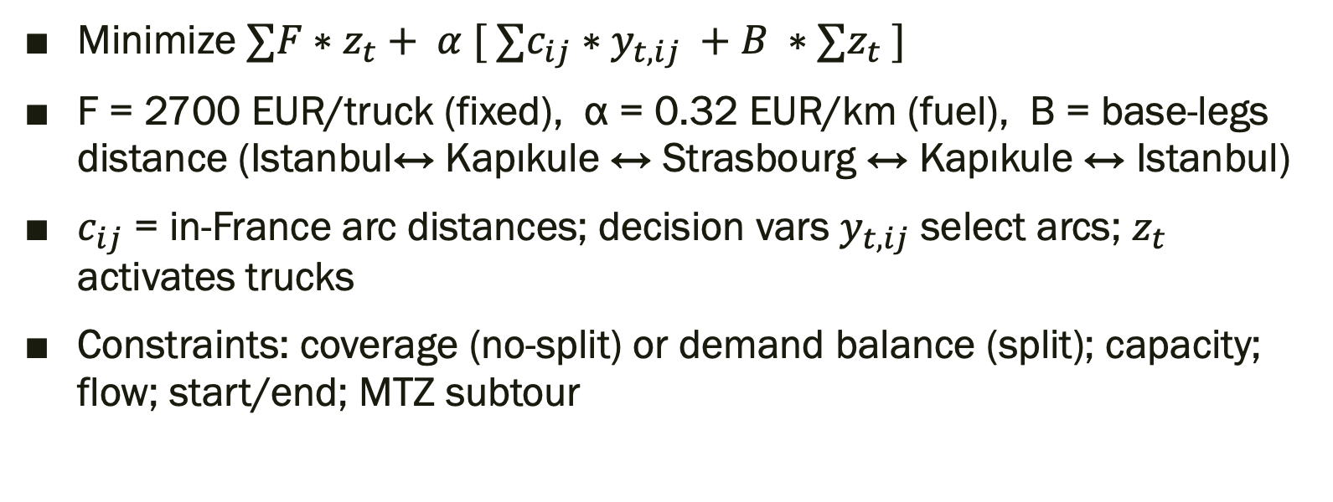
Objective Function
Minimize $∑F∗z_{t}+ α [ ∑c_{ij}∗y_{t,ij} +B ∗∑z_{t} ]$
F = 2700 EUR/truck (fixed), α = 0.32 EUR/km (fuel), B = base‑legs distance (Istanbul↔ Kapıkule ↔ Strasbourg ↔ Kapıkule ↔ Istanbul)
$c_{ij}$ = in‑France arc distances; decision vars $y_{t,ij}$ select arcs; $z_{t}$ activates trucks
Constraints: coverage (no-split) or demand balance (split); capacity; flow; start/end; MTZ subtour

Slide 6
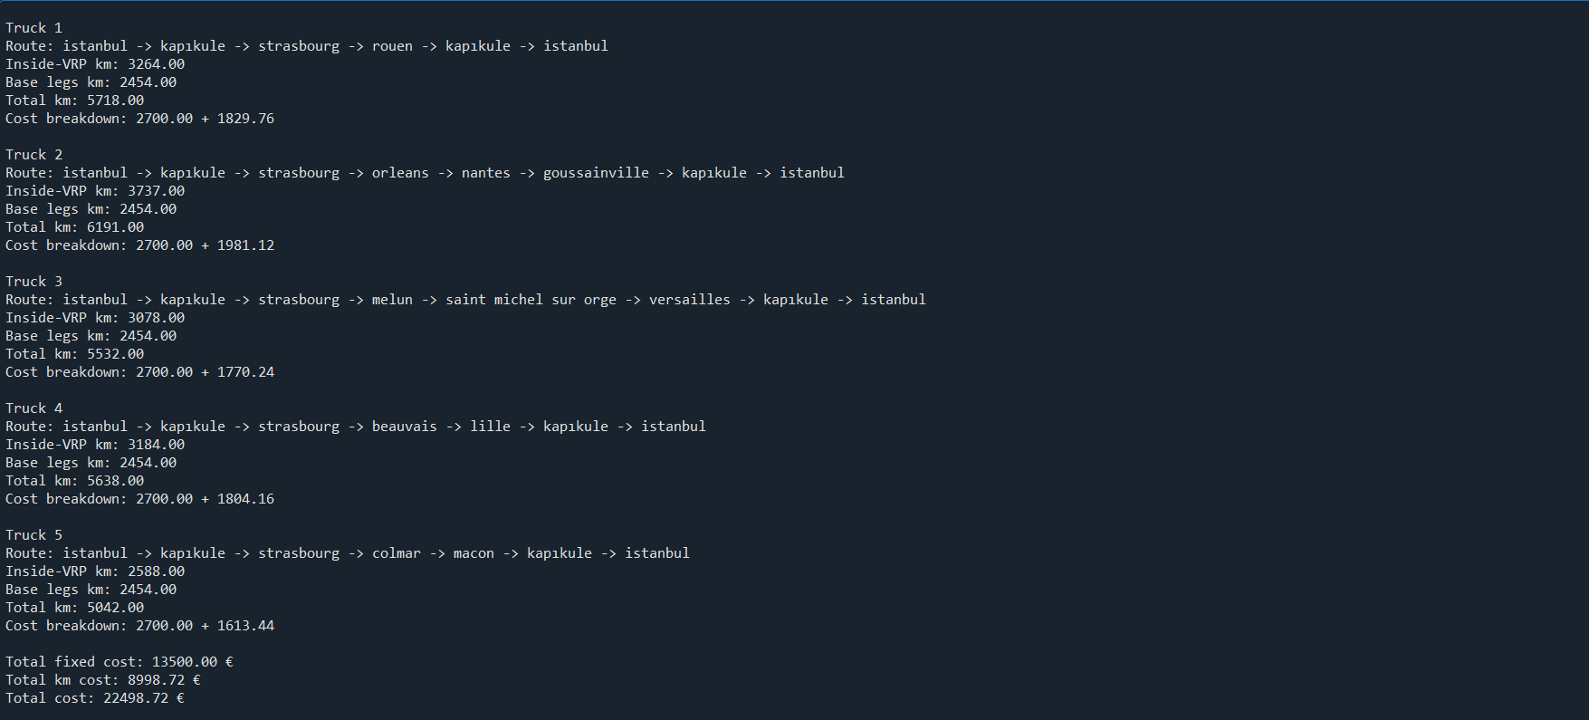
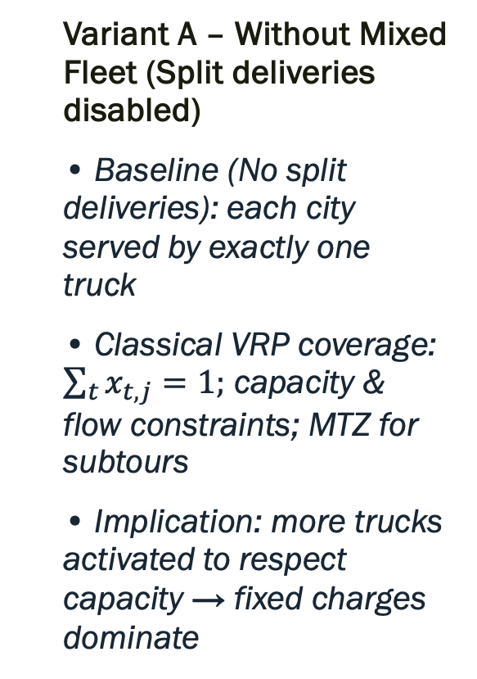
Modeling Approaches
Variant A – Without Mixed Fleet (Split deliveries disabled)
• Baseline (No split deliveries): each city served by exactly one truck
• Classical VRP coverage: $\sum_{t}{x_{t,j}=1;}$ capacity & flow constraints; MTZ for subtours
• Implication: more trucks activated to respect capacity → fixed charges dominate

Slide 7
Model Script — Code Snapshot
# 4) Parametreler
num_trucks = 110
truck_capacity = 23000 # kg (gümrük kanunlarına göre çeker+dorse max 40ton alabilir, 23ton ortalama araca eklenebilen mal)
fixed_cost = 2700 # € / truck (ortalama şoför, hakediş, otoyol masrafları vs.)
km_cost = 0.32 # € / km (tır başına ortalama benzin masrafı km başına, şirketlere özel indirimle birlikte, 3200km için 1000LT benzin ortalama 1€/lt'den)
distance = df.values.tolist()
# 5) Model Kurulumu
base_leg_km = (
distance[origin_index][end_index]
+ distance[end_index][start_index]
+ distance[end_index][origin_index]
)
# 5) Model
model = Model("TruckRoutingVRP")
# Ark kümesi (Strasbourg'dan başlar, Kapıkule'de biter)
arcs = [
(i, j)
for i in [start_index] + delivery_indexes
for j in delivery_indexes + [end_index]
if i != j
]
# y[t,i,j]: t tırı i -> j arkını kullanır
y = model.addVars(num_trucks, arcs, vtype=GRB.BINARY, name="y")
# z[t]: t tırı kullanıldı mı?
z = model.addVars(num_trucks, vtype=GRB.BINARY, name="z")
# x[t,j]: t tırı teslimat j'yi ziyaret etti mi?
x = model.addVars(num_trucks, delivery_indexes, vtype=GRB.BINARY, name="x")
CONTINUES..
# u[t,j]: MTZ sıra değişkeni
u = model.addVars(
num_trucks,
delivery_indexes,
lb=0,
ub=len(delivery_indexes),
vtype=GRB.CONTINUOUS,
name="u",
)
# Amaç: sabit + km maliyeti
model.setObjective(
quicksum(fixed_cost * z[t] for t in range(num_trucks))
+ km_cost
* (
quicksum(
distance[i][j] * y[t, i, j]
for t in range(num_trucks)
for i, j in arcs
)
+ base_leg_km * quicksum(z[t] for t in range(num_trucks))
),
GRB.MINIMIZE,
)

Slide 8
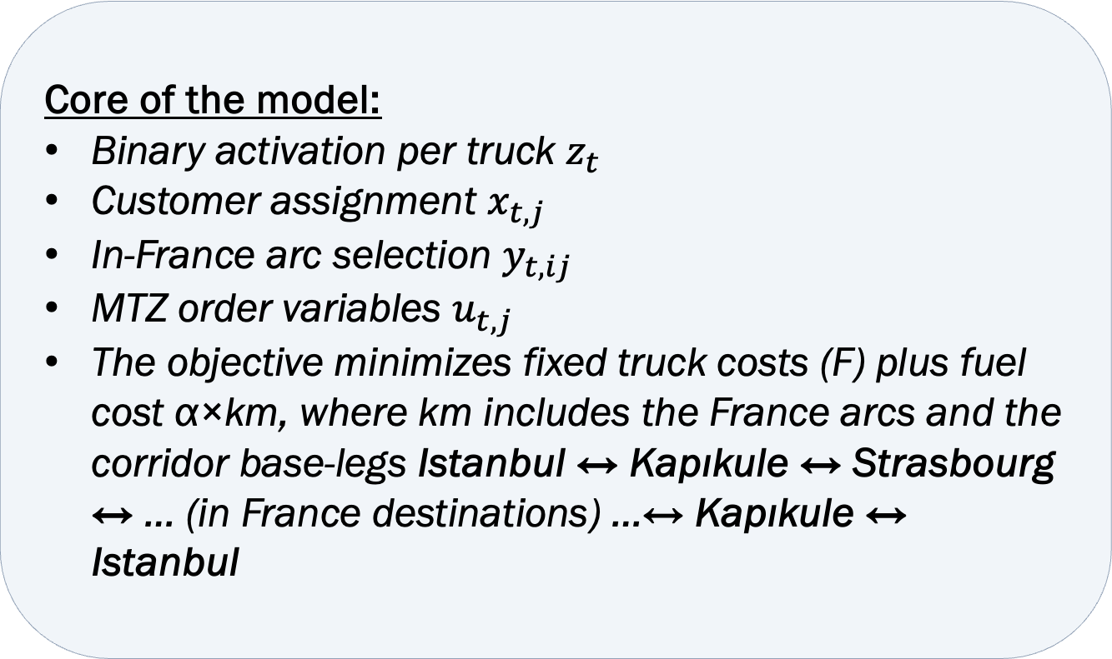
Model Script — Code Snapshot
Core of the model:
Binary activation per truck $z_{t}$
Customer assignment $x_{t,j}$
In-France arc selection $y_{t,ij}$
MTZ order variables $u_{t, j}$
The objective minimizes fixed truck costs (F) plus fuel cost α×km, where km includes the France arcs and the corridor base-legs Istanbul ↔ Kapıkule ↔ Strasbourg ↔ … (in France destinations) …↔ Kapıkule ↔ Istanbul

Slide 9
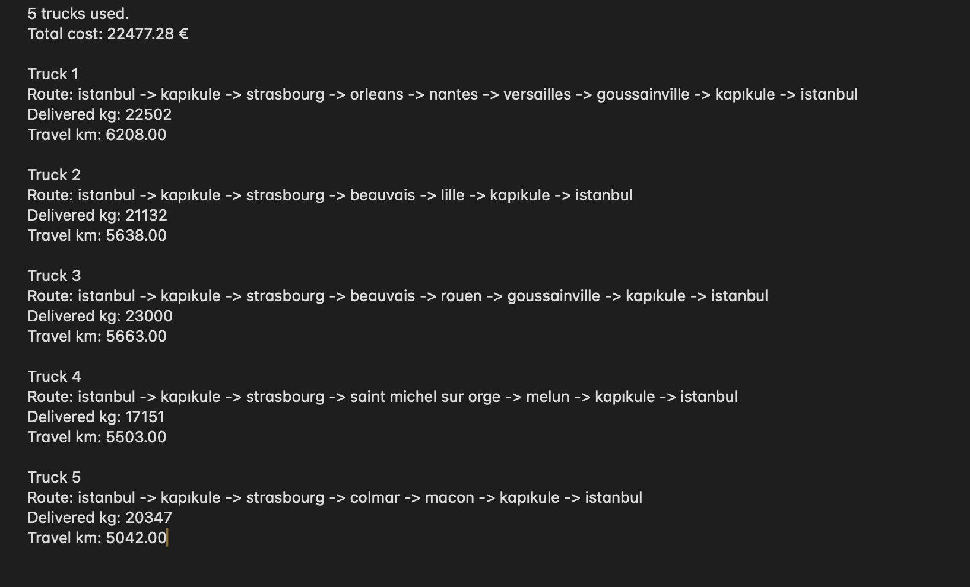

Modeling Approaches
Variant B – With Mixed Fleet (Split Deliveries Enabled)
• Split deliveries enabled (order sharing across trucks) via load variables $w_{tj}$ ≥ 0
• Demand balance: $\sum_{t}{w_{t,j}=demand_{j};Capacity:\sum_{j}{w_{t,j}}}$≤ Q
• Implication: fewer trucks, higher load factors, lower total cost

Slide 10
Model Script — Code Snapshot
# 4) Parametreler
num_trucks = 110
truck_capacity = 23000 # kg (gümrük kanunlarına göre çeker+dorse max 40ton alabilir, 23ton ortalama araca eklenebilen mal)
fixed_cost = 2700 # € / truck (ortalama şoför, hakediş, otoyol masrafları vs.)
km_cost = 0.32 # € / km (tır başına ortalama benzin masrafı km başına, şirketlere özel indirimle birlikte, 3200km için 1000LT benzin ortalama 1€/lt'den)
distance = df.values.tolist()
# demand per location (kg)
demand = {
lower.index("istanbul"): 0,
lower.index("lille"): 6351,
lower.index("macon"): 11580,
lower.index("colmar"): 8767,
lower.index("kapıkule"): 0,
lower.index("beauvais"): 14781,
lower.index("nantes"): 1900,
lower.index("strasbourg"): 0,
lower.index("rouen"): 22483,
lower.index("versailles"): 2139,
lower.index("goussainville"): 8095,
lower.index("saint michel sur orge"): 13218,
lower.index("orleans"): 10885,
lower.index("melun"): 3933,
}
# 5) Model Kurulumu
base_leg_km = (
distance[origin_index][end_index]
+ distance[end_index][start_index]
+ distance[end_index][origin_index]
)
# 5) Model
model = Model("TruckRoutingVRP")
# Ark kümesi (Strasbourg'dan başlar, Kapıkule'de biter)
arcs = [
(i, j)
for i in [start_index] + delivery_indexes
for j in delivery_indexes + [end_index]
if i != j
]
y = m.addVars(num_trucks, arcs, vtype=GRB.BINARY, name="y") # route
x = m.addVars(num_trucks, deliveries, vtype=GRB.BINARY, name="x") # visit
q = m.addVars(num_trucks, deliveries, lb=0.0, name="q") # delivered load
z = m.addVars(num_trucks, vtype=GRB.BINARY, name="z") # truck used
u = m.addVars(num_trucks, deliveries, lb=0.0,
ub=len(deliveries), name="u") # MTZ
# 6) Objective: fixed cost + travel cost
m.setObjective(
quicksum(fixed_cost * z[t] for t in range(num_trucks))
+ km_cost * (
quicksum(dist[i][j] * y[t, i, j] for t in range(num_trucks) for i, j in arcs)
+ base_leg_km * quicksum(z[t] for t in range(num_trucks))
),
GRB.MINIMIZE
)
# --- Demand is fully delivered (can be split)
for j in deliveries:
m.addConstr(quicksum(q[t, j] for t in range(num_trucks)) == demand[j],
name=f"demand_{j}")

Slide 11
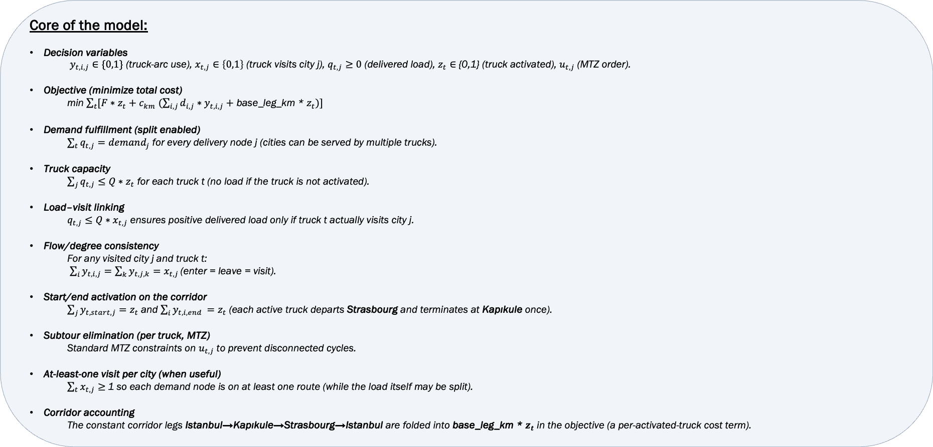
Model Script — Code Snapshot
Core of the model:
Decision variables
$y_{t,i,j}∈\{0,1\}$ (truck-arc use), $x_{t,j}∈\left\{0,1\right\}$ (truck visits city j), $q_{t, j}≥0$ (delivered load), $z_{t}∈${0,1} (truck activated), $u_{t,j}$(MTZ order).
Objective (minimize total cost)
min $\sum_{t}{[F∗z_{t}+c_{km} (\sum_{i,j}{d_{i,j}{∗y}_{t,i,j}+}}$ base_leg_km * $z_{t})]$
Demand fulfillment (split enabled)
$\sum_{t}{q_{t,j}=demand_{j}}$ for every delivery node j (cities can be served by multiple trucks).
Truck capacity
$\sum_{j}{q_{t, j}≤Q}∗z_{t}$ for each truck t (no load if the truck is not activated).
Load–visit linking
$q_{t, j}≤Q∗x_{t,j}$ ensures positive delivered load only if truck t actually visits city j.
Flow/degree consistency
For any visited city j and truck t:
$\sum_{i}{y_{t,i,j}=\sum_{k}{y_{t,j,k}=x_{t,j }}}$(enter = leave = visit).
Start/end activation on the corridor
$\sum_{j}{y_{t,start,j}=z_{t}}$and $\sum_{i}{y_{t,i,end }=z_{t} }$(each active truck departs Strasbourg and terminates at Kapıkule once).
Subtour elimination (per truck, MTZ)
Standard MTZ constraints on $u_{t,j}$ to prevent disconnected cycles.
At-least-one visit per city (when useful)
$\sum_{t}{x_{t, j}≥ }$1 so each demand node is on at least one route (while the load itself may be split).
Corridor accounting
The constant corridor legs Istanbul→Kapıkule→Strasbourg→Istanbul are folded into base_leg_km * $z_{t}$ in the objective (a per-activated-truck cost term).

Slide 12
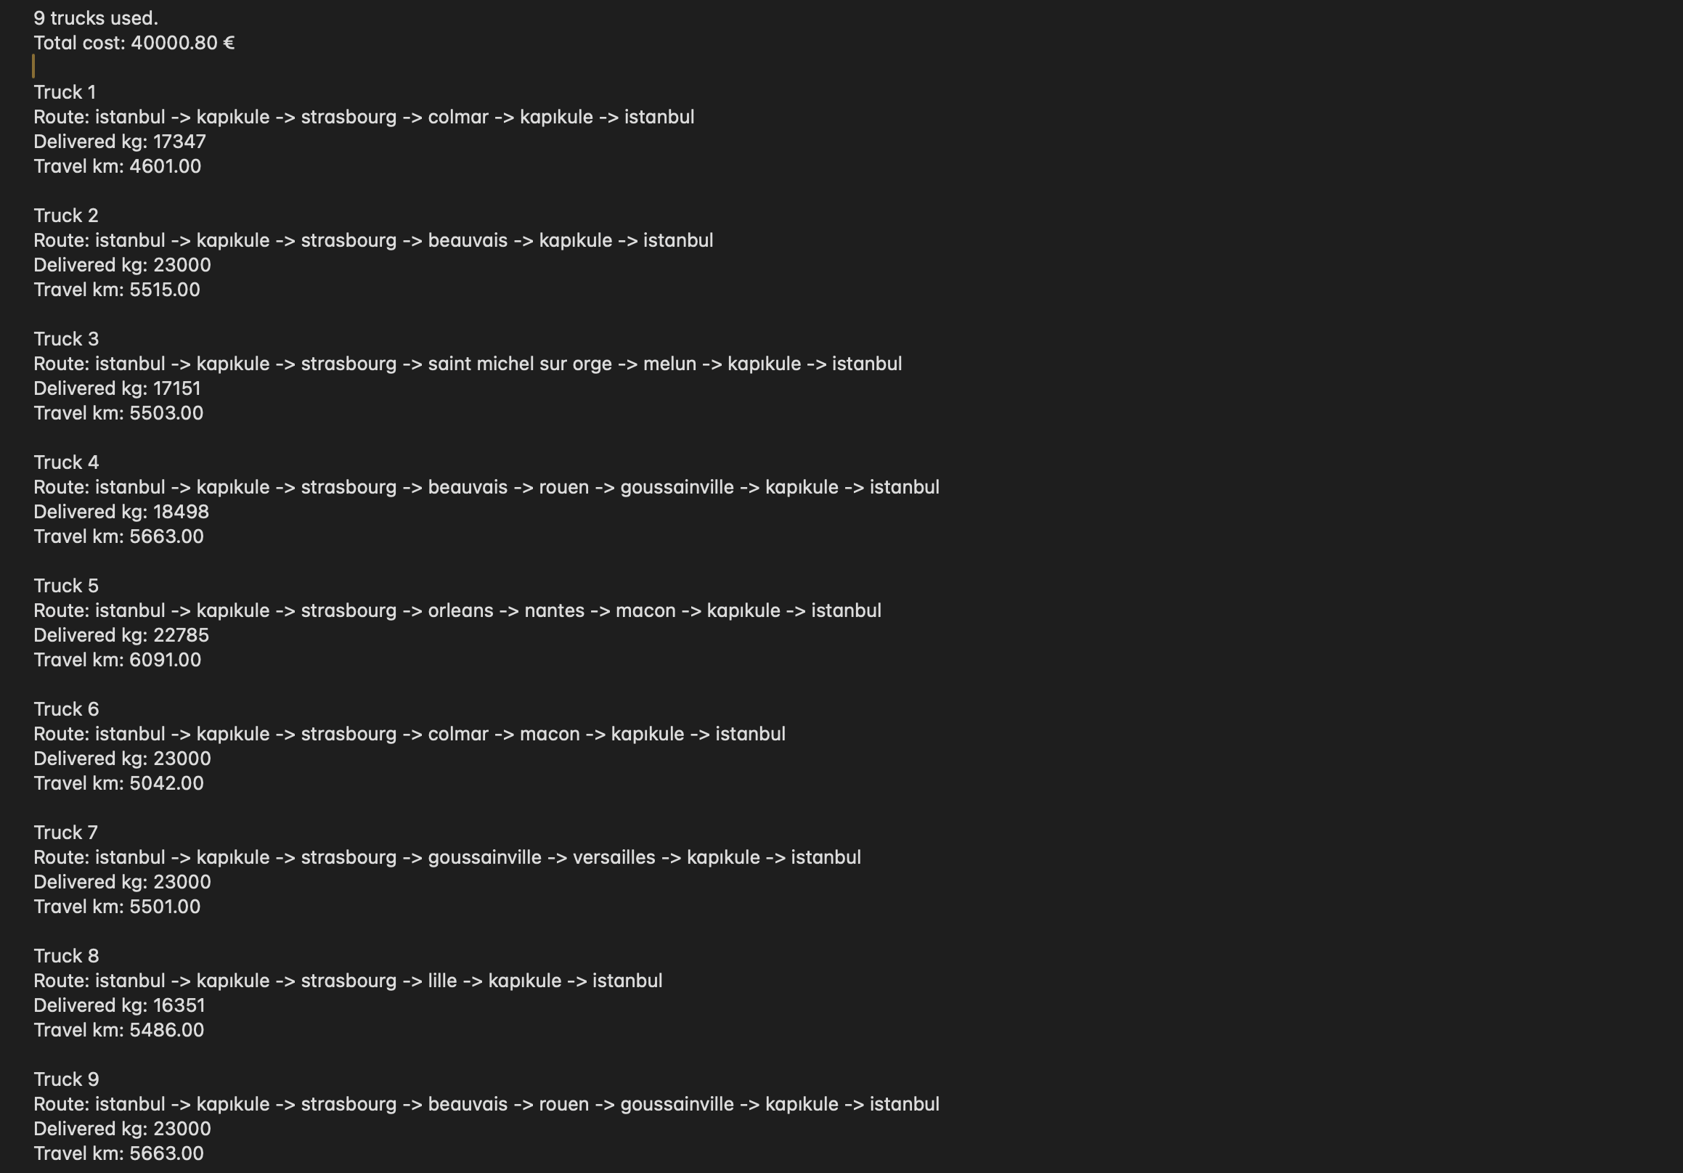
Modeling Approaches
Variant C – With Mixed Fleet (Split deliveries enabled with extra demand)
• Purpose: real-company demands sometimes didn’t force sharing (each city fit in one truck)
• Action: randomly increased demands to stress-test; ensures mixed-filo effect is visible
• Result: stronger cost reduction by minimizing additional truck activations under load

Slide 13
Model Script — Code Snapshot
# 4) Parametreler
num_trucks = 110
truck_capacity = 23000 # kg (gümrük kanunlarına göre çeker+dorse max 40ton alabilir, 23ton ortalama araca eklenebilen mal)
fixed_cost = 2700 # € / truck (ortalama şoför, hakediş, otoyol masrafları vs.)
km_cost = 0.32 # € / km (tır başına ortalama benzin masrafı km başına, şirketlere özel indirimle birlikte, 3200km için 1000LT benzin ortalama 1€/lt'den)
distance = df.values.tolist()
# demand per location (kg)
demand = {
lower.index("istanbul"): 0,
lower.index("lille"): 16351,
lower.index("macon"): 21580,
lower.index("colmar"): 18767,
lower.index("kapıkule"): 0,
lower.index("beauvais"): 24781,
lower.index("nantes"): 11900,
lower.index("strasbourg"): 0,
lower.index("rouen"): 32483,
lower.index("versailles"): 12139,
lower.index("goussainville"): 18095,
lower.index("saint michel sur orge"): 13218,
lower.index("orleans"): 10885,
lower.index("melun"): 3933,
}
# 5) Model Kurulumu
base_leg_km = (
distance[origin_index][end_index]
+ distance[end_index][start_index]
+ distance[end_index][origin_index]
)
# 5) Model
model = Model("TruckRoutingVRP")
# Ark kümesi (Strasbourg'dan başlar, Kapıkule'de biter)
arcs = [
(i, j)
for i in [start_index] + delivery_indexes
for j in delivery_indexes + [end_index]
if i != j
]
y = m.addVars(num_trucks, arcs, vtype=GRB.BINARY, name="y") # route
x = m.addVars(num_trucks, deliveries, vtype=GRB.BINARY, name="x") # visit
q = m.addVars(num_trucks, deliveries, lb=0.0, name="q") # delivered load
z = m.addVars(num_trucks, vtype=GRB.BINARY, name="z") # truck used
u = m.addVars(num_trucks, deliveries, lb=0.0,
ub=len(deliveries), name="u") # MTZ
# 6) Objective: fixed cost + travel cost
m.setObjective(
quicksum(fixed_cost * z[t] for t in range(num_trucks))
+ km_cost * (
quicksum(dist[i][j] * y[t, i, j] for t in range(num_trucks) for i, j in arcs)
+ base_leg_km * quicksum(z[t] for t in range(num_trucks))
),
GRB.MINIMIZE
)
# --- Demand is fully delivered (can be split)
for j in deliveries:
m.addConstr(quicksum(q[t, j] for t in range(num_trucks)) == demand[j],
name=f"demand_{j}")

Slide 14
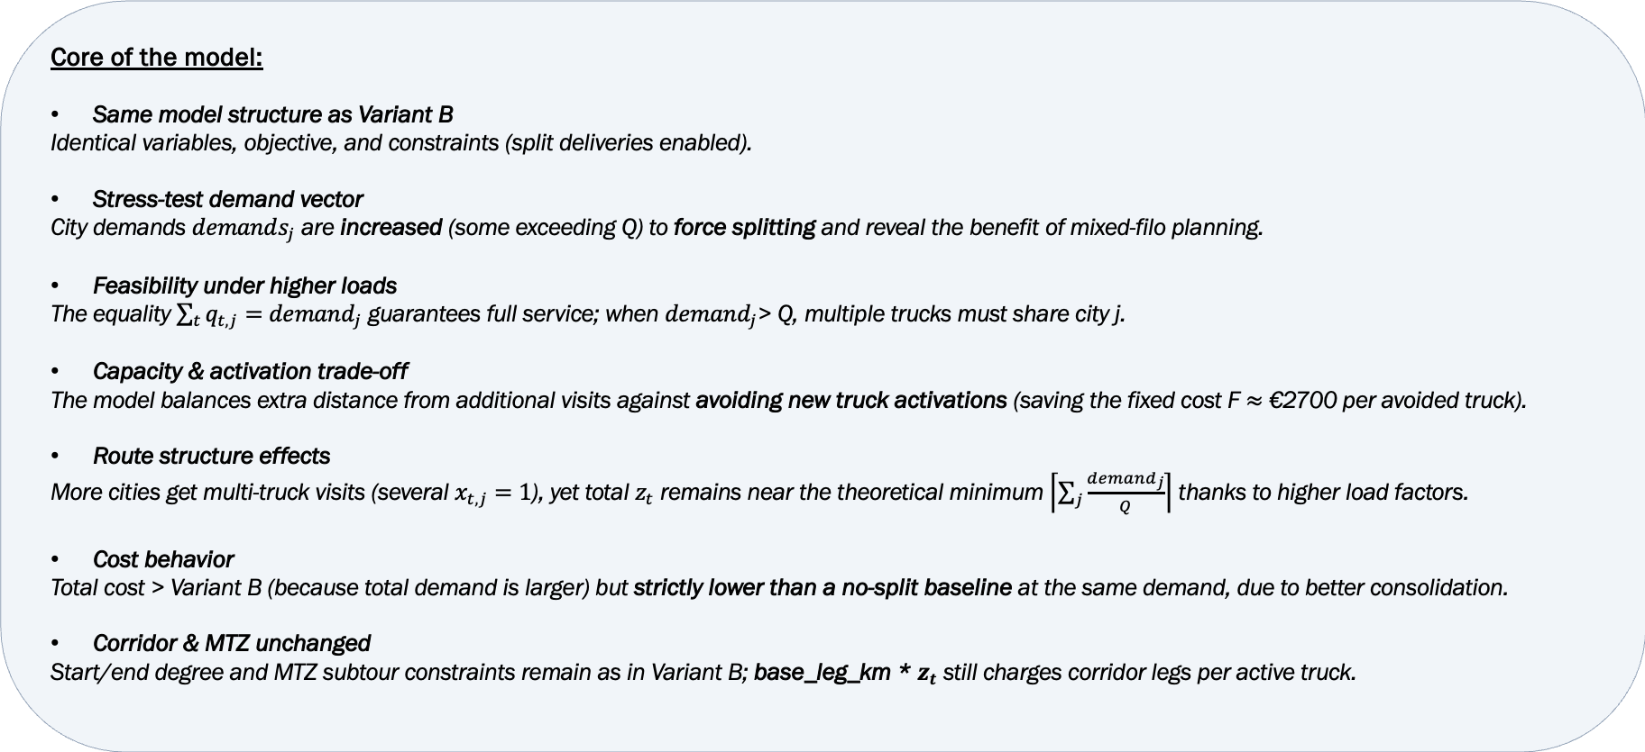
Model Script — Code Snapshot
Core of the model:
Same model structure as Variant B
Identical variables, objective, and constraints (split deliveries enabled).
Stress-test demand vector
City demands $demands_{j}$ are increased (some exceeding Q) to force splitting and reveal the benefit of mixed-filo planning.
Feasibility under higher loads
The equality $\sum_{t}{q_{t,j}=demand_{j}}$ guarantees full service; when $demand_{j}$> Q, multiple trucks must share city j.
Capacity & activation trade-off
The model balances extra distance from additional visits against avoiding new truck activations (saving the fixed cost F $≈$ €2700 per avoided truck).
Route structure effects
More cities get multi-truck visits (several $x_{t, j}=1$), yet total $z_{t}$ remains near the theoretical minimum $\left\lceil \left.\sum_{j}{\frac{demand_{j}}{Q}}\right\rceil \right.$ thanks to higher load factors.
Cost behavior
Total cost > Variant B (because total demand is larger) but strictly lower than a no-split baseline at the same demand, due to better consolidation.
Corridor & MTZ unchanged
Start/end degree and MTZ subtour constraints remain as in Variant B; base_leg_km * $z_{t}$ still charges corridor legs per active truck.

Slide 15
Why “Mixed Fleet (Splitting deliveries)” Reduces Cost?
Fixed-charge leverage: each avoided truck saves ~€2,700
Higher load factors: share orders to approach 23 tons utilization
Avoid awkward edges: near-capacity single-city demands no longer force a whole extra truck
Scales under stress: benefit grows as total demand rises or skews

Slide 16

Stress Test — Extra Demand Rationale
Real demand sometimes let one truck serve a city, hiding split benefits
By increasing demands, the optimizer must split and consolidate intelligently
Outcome: a clear drop in activated trucks and total cost versus baseline

Slide 17

Assumptions & Limitations
No time windows or driving hours; single-period planning (no driver-hour rules).
Fuel price is assumed constant; toll roads are included in the fixed cost by averaging.
Assuming there is only one way (only highway with trucks) to carry the goods.

Slide 18

Future Work
Optimization of ship transportation or mixed ship & road transportation.
CO₂ emissions accounting
Optimization of volume of products while splitting them into trucks.

Slide 19
References & Acknowledgments
Thanks: VIP Lojistik Fleet Operations for data & validation
Old course materials (ENS208, IE311, IE312 etc.)
Gurobi Optimizer

Slide 20
Thank You

